Slide 1
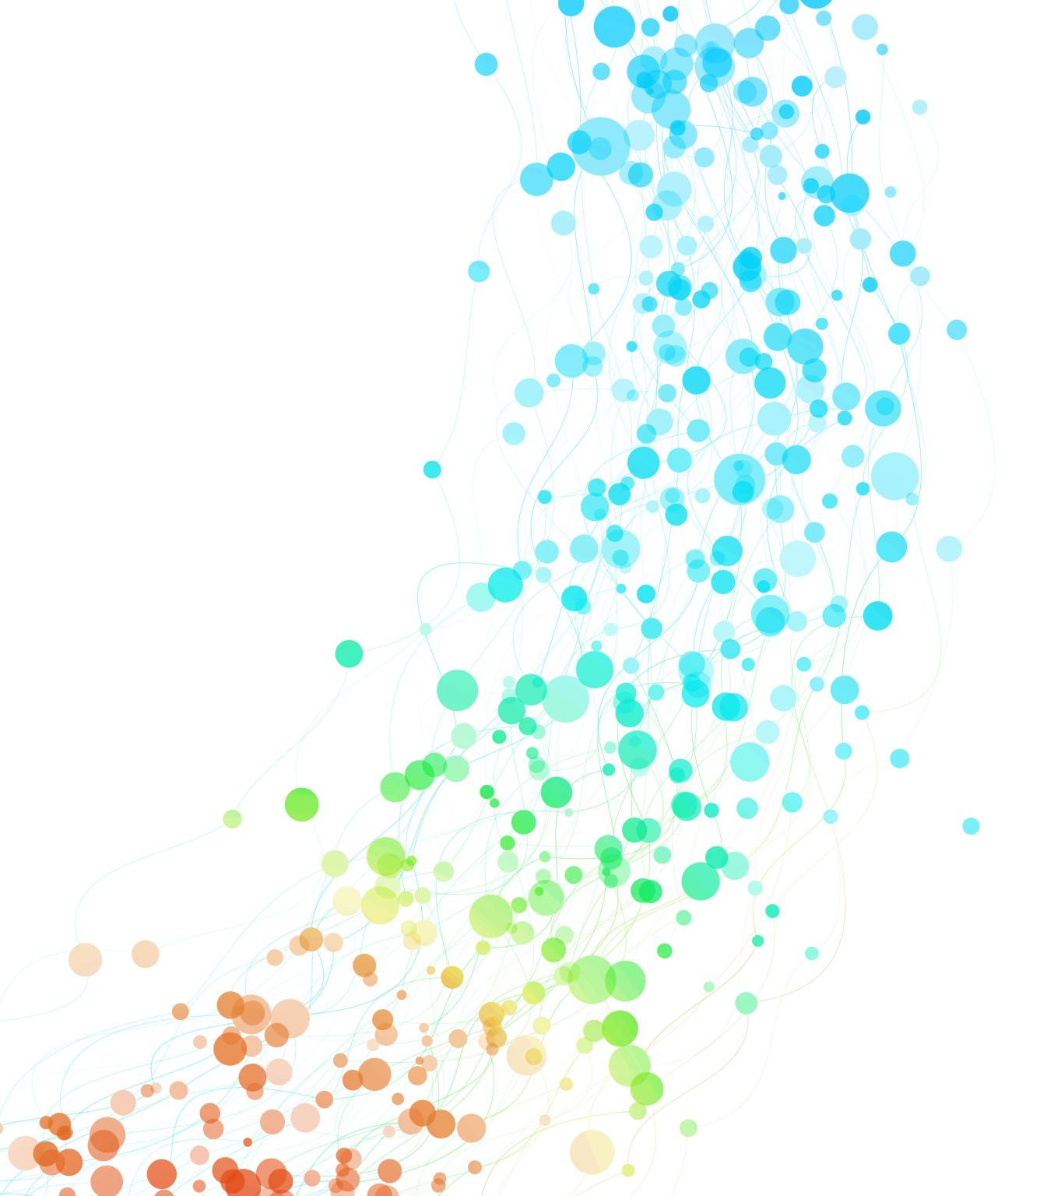
Automated Testing

Slide 2
What is a test?
In software development, "testing" is a crucial process that ensures the quality and functionality of the finished product.
It involves examining the software at various stages to identify and fix bugs, improve performance, and ensure it meets user expectations.
https://www.ionos.co.uk/digitalguide/websites/website-creation/what-does-the-404-not-found-error-mean/

Slide 3
The Testing Pyramid
Manual Testing
End-to-End Testing
Integration Testing
Component Testing
Unit Testing

Slide 4
The Testing Pyramid
Unit Testing - Testing individual units of code (functions, classes) in isolation; for example, testing views
Component Testing – Testing different functions and classes together to check if a component is working properly; for example, testing the front-end and the database separately
Integration Testing – Testing if the different components are working with each other; for example, front-end with database or front-end with google maps API
End to End Testing – Testing if the complete software is working flawlessly; for example, a site made by Django is working with all the APIs and a database
Manual Testing – Testing manually those features which are hard to write test for or are too complex to write an automated test. Automated testing is what you should always go for

Slide 5
What are automated tests?
Tests are simple routines that check the operation of your code
Testing operates at different levels
With automated tests, the testing work is done by the system
In every test we check the received output with the expected output to know if the test was passed or failed
Create a set of tests once, and as you make changes to your app, you can check that your code still works as you originally intended

Slide 6
Why create tests?
Tests save you time; instead of going through all permutations of data manually, it can be tested automatically
Tests don’t just identify problems; they help prevent them. When writing the tests, you think of all the ways that can make your code go wrong so you think about those aspects preemptively
Tests make your code more attractive (to others). A well tested code can be trusted as the chance of it going wrong is minimal and in case there is a change in code, it can be rightly tested
Tests help teams work together; Tests guarantee that colleagues don’t inadvertently break your code hence any change can be easily corrected by anyone working on the code

Slide 7
Test Driven Development (TDD)
Write a test before you actually write the code!
Seems counter-intuitive, but:
Similar to what many people do already while writing the code
Helps in describing a problem, and a code is written by being mindful to it
TDD formalizes the problem in a test case
Easier to write tests as you go along rather than to add them later
You however need to find a balance between writing a code and writing the tests

Slide 8
Polls has a bug!
The Question.was_published_recently() method returns True if the Question was published within the last day (which is correct) but also if the Question’s pub_date field is in the future (which certainly isn’t).
Test by creating a Question whose publication date is in the future
>>> import datetime >>> from django.utils import timezone >>> from polls.models import Question >>> # create a Question instance with pub_date 30 days in the future >>> future_question = Question(pub_date=timezone.now() + datetime.timedelta(days=30)) >>> # was it published recently? >>> future_question.was_published_recently() True

Slide 9
Writing the first test!
Put the following in the tests.py file in the polls application:
import datetime from django.test import TestCase from django.utils import timezone from .models import Question
class QuestionModelTests(TestCase): def test_was_published_recently_with_future_question(self): """ was_published_recently() returns False for questions whose pub_date is in the future. """ time = timezone.now() + datetime.timedelta(days=30) future_question = Question(pub_date=time) self.assertIs(future_question.was_published_recently(), False)

Slide 10
Running test
In the terminal, we can run our test:
$ python manage.py polls
You will see something close to this:
Creating test database for alias 'default'... System check identified no issues (0 silenced). F ====================================================================== FAIL: test_was_published_recently_with_future_question (polls.tests.QuestionModelTests) ---------------------------------------------------------------------- Traceback (most recent call last): File "/path/to/mysite/polls/tests.py", line 16, in test_was_published_recently_with_future_question self.assertIs(future_question.was_published_recently(), False) AssertionError: True is not False ---------------------------------------------------------------------- Ran 1 test in 0.001s FAILED (failures=1) Destroying test database for alias 'default'...

Slide 11
The series of events
manage.py test polls looked for tests in the polls application
it found a subclass of the django.test.TestCase class
it created a special database for the purpose of testing
it looked for test methods - ones whose names begin with test
in test_was_published_recently_with_future_question it created a Question instance whose pub_date field is 30 days in the future
… and using the assertIs() method, it discovered that its was_published_recently() returns True, though we wanted it to return False
The test informs us which test failed and even the line on which the failure occurred.

Slide 12
Fixing the bug
Amend the method in models.py, so that it will only return True if the date is also in the past:
def was_published_recently(self): now = timezone.now() return now - datetime.timedelta(days=1) <= self.pub_date <= now
And run the test again
Creating test database for alias 'default'...
System check identified no issues (0 silenced).
.----------------------------------------------------------------------
Ran 1 test in 0.001s
OK
Destroying test database for alias 'default'...

Slide 13
How did we fix it?
The main correction is happening in this statement:
return now - datetime.timedelta(days=1) <= self.pub_date <= now
The entire expression combines the conditions using and (implied by the double comparison).
It returns True only if these conditions are met:
The pub_date is within the last 24 hours (from 24 hours ago up to the current time).
The pub_date is not beyond the current time in future.

Slide 14
More comprehensive tests
Add the following to tests.py:
def test_was_published_recently_with_old_question(self): """ was_published_recently() returns False for questions whose pub_date is older than 1 day. """ time = timezone.now() - datetime.timedelta(days=1, seconds=1) old_question = Question(pub_date=time) self.assertIs(old_question.was_published_recently(), False) def test_was_published_recently_with_recent_question(self): """ was_published_recently() returns True for questions whose pub_date is within the last day. """ time = timezone.now() - datetime.timedelta(hours=23, minutes=59, seconds=59) recent_question = Question(pub_date=time) self.assertIs(recent_question.was_published_recently(), True)

Slide 15
Testing views
Django provides a test Client to simulate a user interacting with the code at the view level.
We can use it in tests.py or even in the shell.
>>> from django.test.utils import setup_test_environment >>> setup_test_environment()
setup_test_environment() installs a template renderer which will allow us to examine some additional attributes on responses such as response.context (Note that this method does not set up a test database)
Next, we need to import the test client class
>>> from django.test import Client >>> # create an instance of the client for our use >>> client = Client()

Slide 16
-END-

